Slide 1



JLAB Front-end and Trigger Electronics
Heavy Photon Search
Collaboration Meeting
26 May 2011
R. Chris Cuevas
  Front-end and Trigger Hardware Descriptions
    Present hardware status
    Pipeline Trigger System
    Past and Near Future Implementation plans
  Schedule
    Requirement definitions
    Update firmware for new requirements
    Testing and commissioning
  Summary

Slide 2
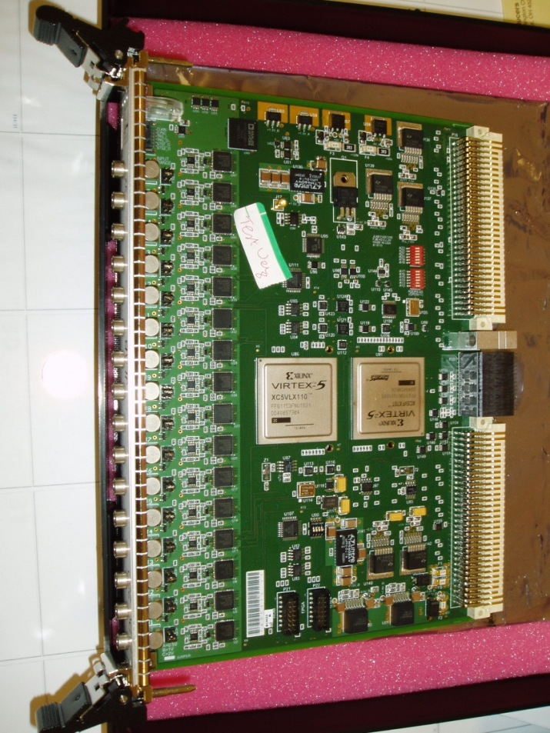
Flash ADC 250MHz
Specification Highlights – Version 2
16 Channel, 12-bit
  4ns continuous sampling
  Input Ranges: 0.5V, 1.0V, 2.0V
  (user selectable via jumpers)
  Bipolar input, Full Offset Adj.
  Intrinsic resolution – σ = 1.15 LSB.
  2eSST VME64x readout
  Several modes for readout data format
    Raw data
    Pulse sum mode (Charge)
    TDC algorithm for timing on LE
  Multi-Gigabit serial data transport of trigger information through VXS fabric
  On board trigger features
    Channel summing
    Channel coincidence, Hit counters
  2 Pre-production units extensively tested
  Automatic Test Station is complete
  Engineering Run – in Production
    18 Hall D
    17 Hall B
    May Delivery
  Production Procurement FY12 (>$2M).
2

Slide 3
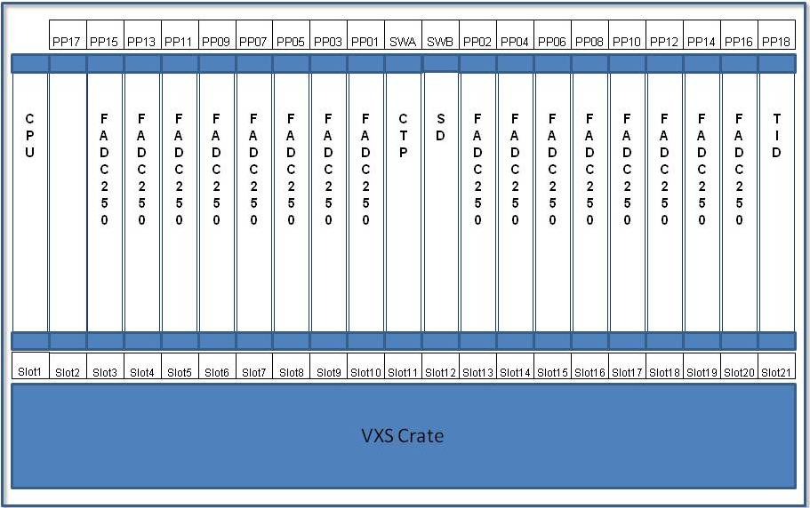
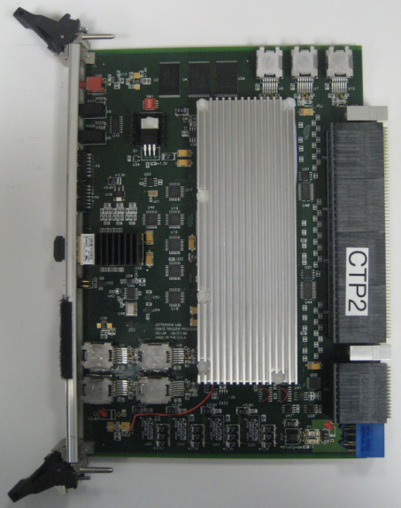
Crate Trigger Processor
H. Dong
J. Wilson
Includes 3 Xilinx VirtexV FX70T that support 5Gbp/s
Crate Trigger Processor computes a crate-level energy sum (or hit pattern)
Computed crate-level value sent via 10Gbps fiber optics to Global Trigger Crate (32bits every 4ns)
CTP
Fully populated front end crate for readout of 12GeV detector signals
256 coaxial input ‘channels’
VXS serial fabric is used to transfer trigger information forward to Global Trigger system.
MTP Parallel Optics
10Gb/s to SSP
VXS Connectors
Collect serial data from 16 FADC-250
3

Slide 4
Trigger Hardware Status
Flash ADC 250Msps ( FADC250 )
  Initial version 2 boards have been thoroughly tested and are working in the lab.
  Will receive 35 pre-production boards in May!
  Automatic board level verification test station is complete.
  CODA library ‘driver’ updated and will be used for two full crate DAq testing
Crate Trigger Processor ( CTP )
  We have 4 fully functional CTP modules
  2 latest CTPs include FPGA that support higher Gigabit speed (5Gbp/s)
  A new CTP was used for verification of new WIENER VXS backplane
  FADC250-V2 Gigabit outputs verified with CTP @2.5Gb/s per lane!
  Collects trigger data (SUM) from 16 FADC250 modules within one crate
  ( 16 bit sum every 4ns from 16 boards equals 64Gb/s!)
  Transports trigger data over fiber to Global Trigger crate (SSP)
    10Gbp/s capability ( 8Gbp/s successfully tested )
4

Slide 5
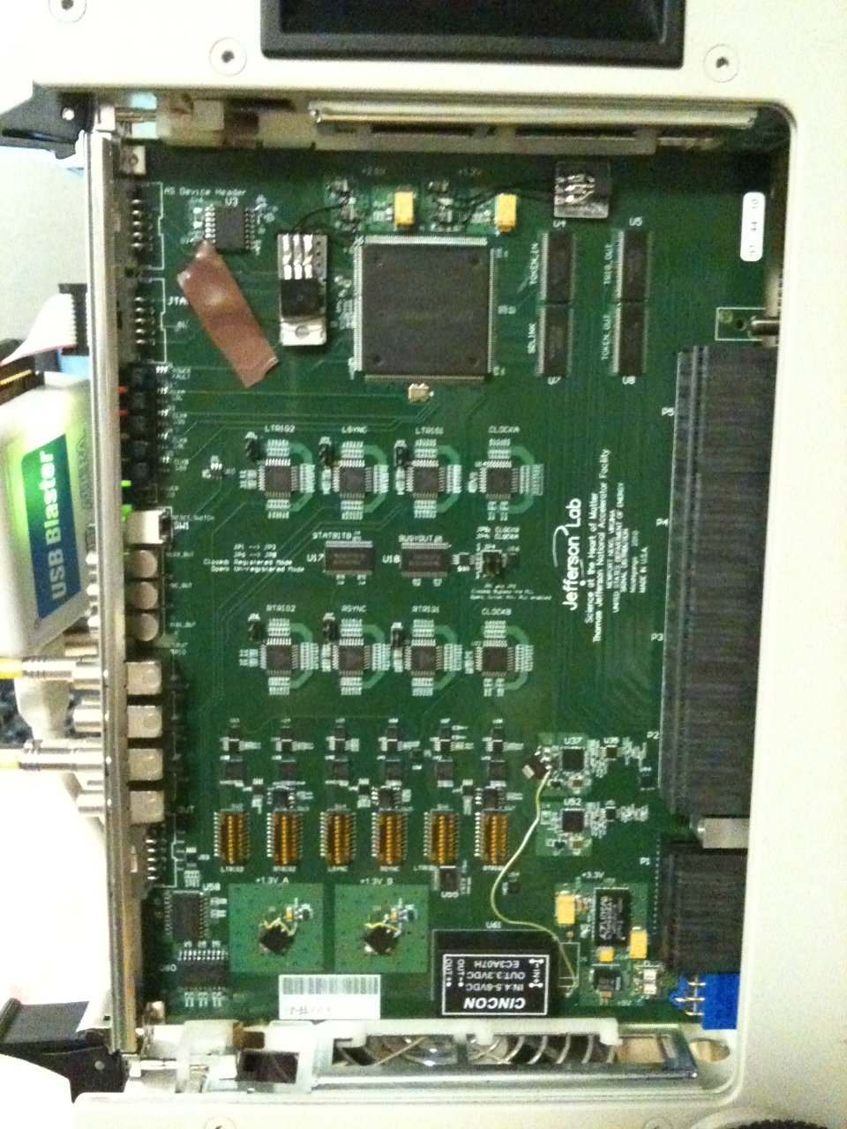
Crate Level – Signal Distribution (SD) -Rev 1
N. Nganga
Two boards fully assembled and essential functions have been tested
Rev_1 includes jitter attenuation PLL circuit that significantly reduces clock jitter to final payload (FADC250) slots
  Jitter Attenuation achieves 1.5ps rms measured at payload slots.
I^2C programming functions via TI have been tested
Circuit corrections (ECO) have been identified and implemented in schematic and circuit board in preparation for pre-production order.
We have the components and front panels required for a pre-production order of 6 units. Order by late summer.
Production quantities:
  Hall D needs 49 SD units
  Hall B (and other Halls) need 30 units
VITA 41
Switch
Slot
Connectors
5
14

Slide 6
Trigger Hardware Status
Signal Distribution ( SD )
  Precision low jitter fan-out of ADC clock, trigger and synch signals over VXS backplane to FADC250 modules
  Revisions include clock jitter attenuation PLL
  Two Rev-2 boards have been tested with Trigger Interface
  A few power supply issues have been resolved, and updates to firmware have been completed to support PLL for jitter attenuation
  I^2C communication with latest Trigger Interface is complete
  Two boards will be used for full crate testing before ordering pre-production quantities.
  Pre-production quantity of six boards will be ordered as soon as two crate DAq test verifications are complete. (June, 2011)
  We have components and front panels for at least six more units
6

Slide 7
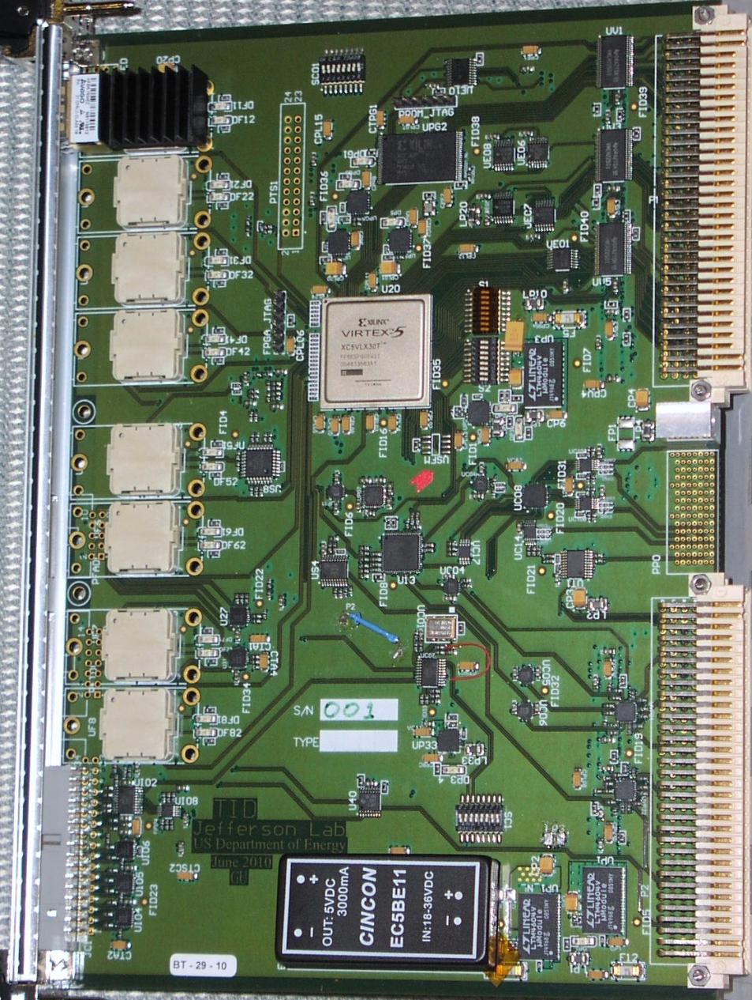
Trigger Interface - Distribution
W. Gu
DAQ Group
TID Components
VME→PROM
(FPGA firmware)
Emergency/remote
re-programming
‘Legacy’
Trigger
Supervisor
Interface
Xilinx
VirtexV
LX30T-FG665
VME 64x
Eight
Optical Transceivers
HFBR-7924
VXS P0
TD mode: from SD
TI/TS mode: to SD
One dedicated link for redundant data collection
External I/O
(trg, clk…)
Trg/Clk/Syc
outputs
On row_C
7

Slide 8
Trigger Interface - Distribution
W. Gu
DAQ Group
5/26/2011
Testing is complete and this TI revision is ready for a pre- production order. Order will be placed as soon as two crate DAq testing is verified.
Minor circuit modifications (ECO) have been completed and the circuit board files updated in preparation for the pre-production order.
Ten pre-production units will be ordered and tested by end of summer. Final production quantities as follows:
  Hall D: 56 units
  Other Halls: 35+ units
  Function Highlights
  Direct link to Trigger Supervisor crate via parallel fiber optic cable
  Distributes precision clock, triggers, and sync to crate SD modules
  Board design supports both TI and TD functions, plus can supervise up to eight front end crates.
  Manages crate triggers and ReadOut Controller events
8

Slide 9
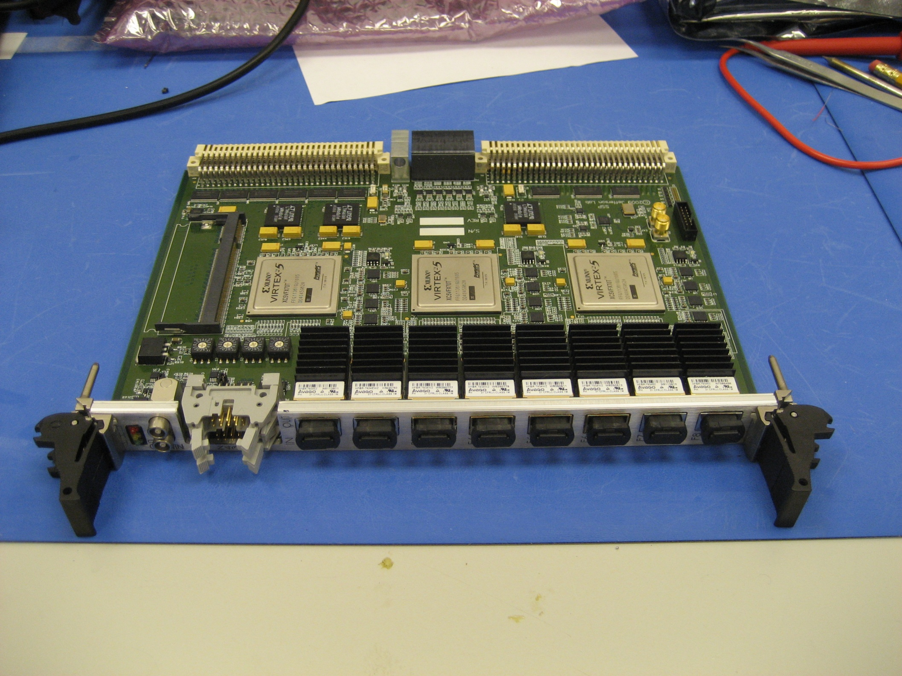
Sub-System Processor
Ben Raydo
9-Sept-2010
VME64x
(2eSST support)
VXS-P0
(up to 16Gb/s to each GTP)
Optional DDR2 Memory Module (up to 4GByte)
2x NIM
(bidirectional)
4x ECL/PECL/LVDS In 4x LVDS Out
8x Fiber Ports --10Gb/s each from CTP )
Collects Trigger Information from 8 Front End Crates
9

Slide 10
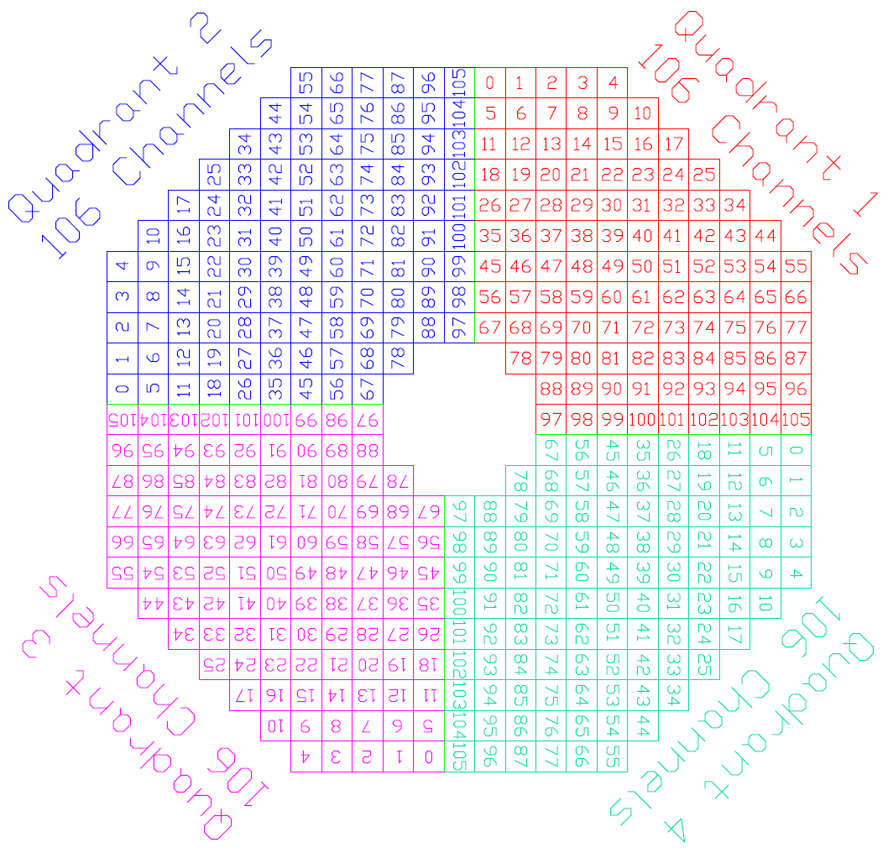
JLab Hall B 6 GeV DVCS Trigger Implementation
B. Raydo
424 channel Inner Calorimeter with APD readout
APD amplified signal is split to drive Discriminator, and QADC
Dual Discriminator output to drive TDC and CAEN 1495 logic modules
Discriminator pulse widths are 40ns
CAEN 1495 used for each quadrant trigger
and for combining the quadrants to form the final trigger.
CAEN 1495 boards run as 5ns state machines, and sample 424 discriminated signals every 15ns to determine hit crystals
Signals that pass Threshold are used in Quadrant Cluster Detection Algorithm to locate hits on a 3 x 3 window for all adjacent crystals
Final CAEN 1495 combines Quadrant information and compares against a programmable cluster count threshold to determine final trigger
Beam View
10

Slide 11
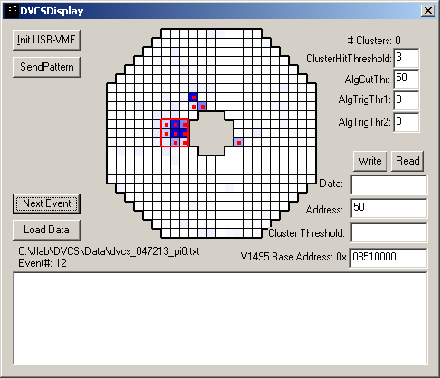
JLab Hall B 6 GeV DVCS Trigger Implementation
B. Raydo
Very successful operation of new trigger algorithm based on commercial discriminators and logic boards.
FPGA firmware developed on CAEN 1495 format and quadrant plus main trigger algorithms met specified cluster algorithm requirements.
Single threshold energy resolution
Programmable trigger on 1-31 detected clusters
Programmable cluster definitions
Programmable Mask for channel inputs
Fast (5ns) logic with total trigger transition delay <70ns
DVCS Cluster Finding Display
11

Slide 12

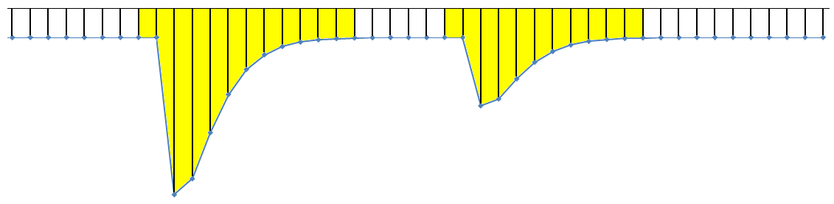

Flash ADC Implementation
To trigger
logic
Trigger Pulse
Pre-Processing
Capture Window
Energy & Time Algorithms
Readout
Sample Clock
Event #1
Event #2
detector
signal
FADC
8μs ADC Sample Pipeline
Trigger #1
Trigger #2
Trigger Input
Sampling Flash ADC stores digitized signal in 8us memory
Trigger input copies a window of the pipeline and extract pulse charge and time for readout
Trigger output path contains detailed information useful for cluster finding, energy sum, etc.
Hardware algorithms provide a huge data reduction by reporting only time & energy
estimates for readout instead of raw samples
12

Slide 13
Flash ADC Implementation
Energy Sum Trigger Example
CH-1
12 Bits
VXS Gigabit serial fabric
Transfer rate of 4Gb/s per board
(2 full duplex lanes @2.5Gb/s
Transfer 16-bit Energy Sum every 4ns
Energy Sum
16 Channels
To Crate
Trigger
Processor
(VXS Switch Card)
Xilinx FPGA Trigger Function
Pre-Processing
APD Signals
+
CH-16
12 Bits
CH-16
CH-1
Global Trigger
Round Trip Latency <3us
8μs ADC Sample Pipeline
Energy & Time Algorithms
VME
Readout
13

Slide 14
Flash ADC Implementation
Cluster Finding with Energy Resolution/Channel
CH-1
12 Bits
VXS Gigabit serial fabric
Transfer rate of 4Gb/s per board
(2 full duplex lanes @2.5Gb/s)
Use 32ns ‘window’ to Transfer 16-bytes
Each channel is 1 byte:
6 bit Sum + 2 bits for clock recovery
6 bit Sum (Truncated)
Every Channel
To Crate
Trigger
Processor
(VXS Switch Card)
Xilinx FPGA Trigger Function
Pre-Processing
APD Signals
16 Bytes in 32ns
Meets the 4Gb/s transfer bandwidth
Per board
CH-16
12 Bits
2 bit clock encoding
Allows 8ns clock recovery
in 32ns ‘window’
6 Bit Sum
CE1
CE0
CH-1
CH-16
32 ns
CH-1
6 Bit Sum
CE1
CE0
CH-16
Global Trigger
Round Trip Latency <3us
8μs ADC Sample Pipeline
Energy & Time Algorithms
VME
Readout
14

Slide 15
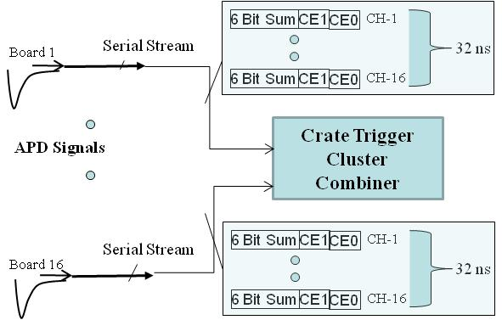
Crate Trigger Processor Point of View
Cluster Finding with Energy Resolution/Channel
6 Bit Sum
CE1
CE0
CH-1
Sub-System Processor
Board 1
Serial Stream
32 ns
6 Bit Sum
CE1
CE0
CH-16
4 x 2.5Gb/s fiber links
From crates to
Sub-System Processor
Final Cluster Algorithm
To process all calorimeter channels
Cluster Energy Trigger
Will have much more resolution than initial DVCS implementation
Crate Trigger
Cluster Combiner
8Gb/s
APD Signals
Serial Stream
6 Bit Sum
CE1
CE0
CH-1
Board 16
32 ns
6 Bit Sum
CE1
CE0
CH-16
8Gb/s
15

Slide 16
Activities to be completed
Define requirements for readout electronics and trigger hardware
  Expected signal rates
  Expected signal amplitudes/pulse widths
  Expected trigger rates
  Calorimeter APD channels only? Or are there Hodoscope channels?
  Channel sum resolution → 6 bits proposed. Is this acceptable?
Firmware development can begin once requirements are complete. (June 2011)
  - Must create realistic work plan for firmware on FADC250, CTP and SSP
  - Plan must account for simulation and testing
Hardware Status
  - We have VXS crates, Crate Trigger Processors, SubSystem Processor, Trigger Interface
  Signal Distribution and Read-Out Controllers
  - 35 FADC250 are presently at the assembly company and delivery is imminent
  - FADC250 will need acceptance testing and then will be fully qualified in a two crate test (Summer 2011)
Pre-commissioning
  - Hall Installation activities:
    =Cabling, VXS crates and readout module setup/configuration
    =System level testing/troubleshooting
16

Slide 17
Summary
Synchronous Flash ADC system samples detector signals at 4ns
  - Buffer digitized signal data for 8us (per channel)
  - Trigger algorithms run at 4ns and result data are transferred serially (VXS or Fiber)
  - If Physics ‘Trigger’ condition satisfied,
    Distribute Trigger signal to front end crates to initiate readout
    System is capable of high (>100KHz) trigger rates with >100MB/s VME64x readout
    VXS fabric allows for “Smart” Trigger algorithm results to be transferred to global trigger modules
Front-End Flash ADC-250 boards are in pre-production
We have the required trigger modules for a full two crate system
  SD → VXS Signal Distribution board
  TI → Trigger Interface board
  CTP → Crate Trigger Processor board
  SSP → Sub-System Processor board
  Plenty of VXS crates on site
Requirements, Firmware development, and installation work plans need to be detailed
17

Slide 18
Backup Slides
All sorts of good stuff

Slide 19
CODA
Two crate Trigger Signal
From SSP to TI(TS)
LINUX
Dell 2GHz Xeon
Dual core 1U
“DSC8”
Ethernet
Fiber Link
Network Switch
256 inputs/crate
APD amplified signal
will drive input of FADC
Plenty of channels for
424 calorimeter outputs
LINUX
“DSC9”
19

Slide 20
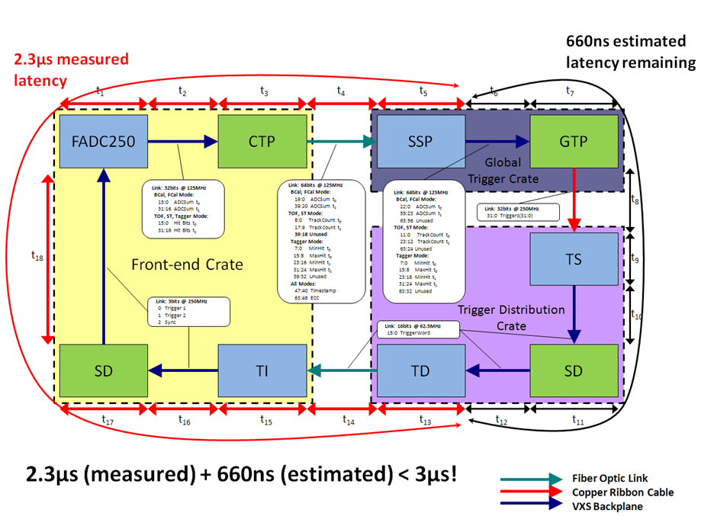
GlueX Level 1 Timing
20

Slide 21
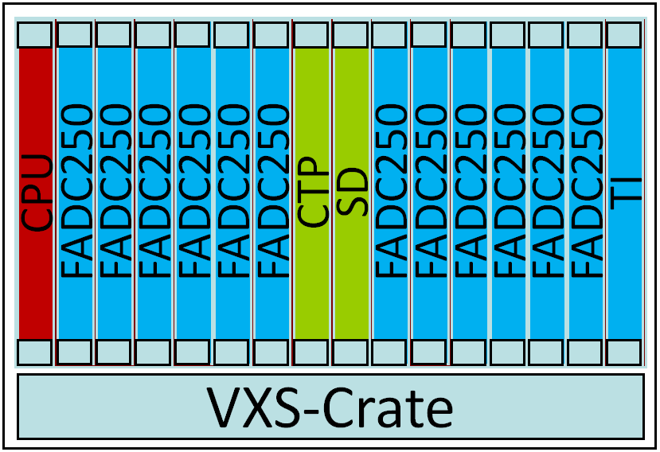
Level 1 & Trigger Distribution
Global Trigger Crate
Trigger Decisions
Trigger Distribution Crate
CPU
SSP
SSP
SSP
SSP
SSP
SSP
GTP
GTP
SSP
SSP
SSP
SSP
SSP
SSP
TI
CPU
TD
TD
TD
TD
TD
TD
SD
TD
TD
TD
TD
TD
TD
TS
L1 Subsystem Data Streams (hits & energy)
VXS-Crate
VXS-Crate
Fiber Optic
Links
SSP can manage
8 CTP
(Crates)
Fiber Optic
Links
TD can manage
8 TI
(Crates)
Clock
Trig1
Trig2
Sync
Busy
Front-End Crates
VME Readout to Gigabit Ethernet
Up to 128 front-end crates
21

Slide 22
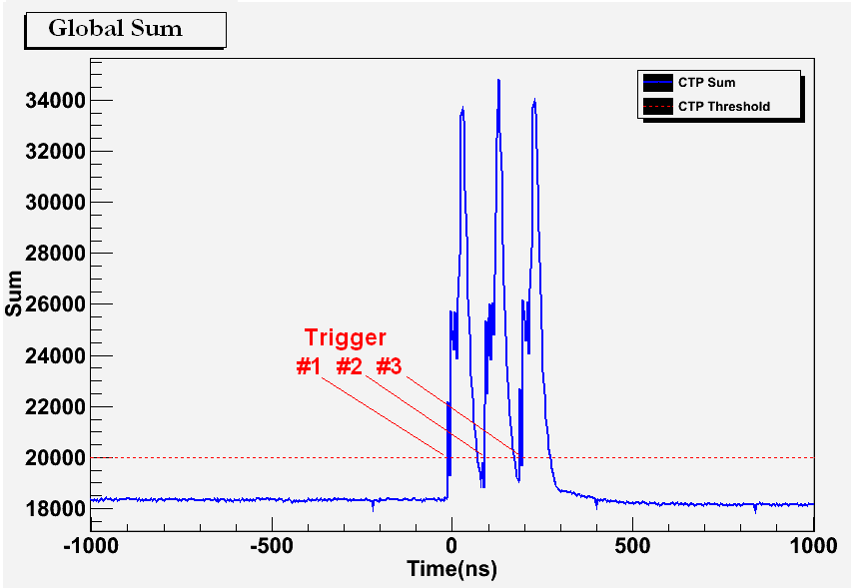
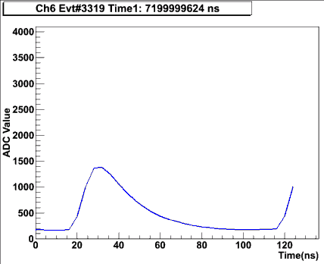
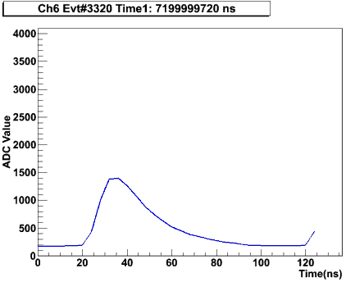
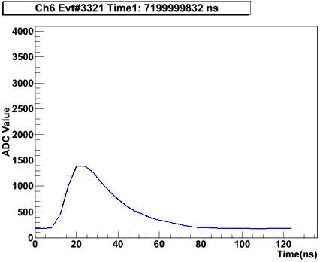
Synchronized Multi-Crate Readout
CTP #2 is also acting as an SSP (by summing the local crate + CTP#1 sum over fiber
A programmable threshold is set in CTP, which creates a trigger when the global sum (6 FADC boards => 96 channels) is over threshold.
Example test with a burst of 3 pulses into 16 channels across 2 crates/6 FADC modules
A 2μs global sum window is recorded around the trigger to see how the trigger was formed:
Example Raw Event Data for 1 FADC Channel:
B. Raydo

Slide 23
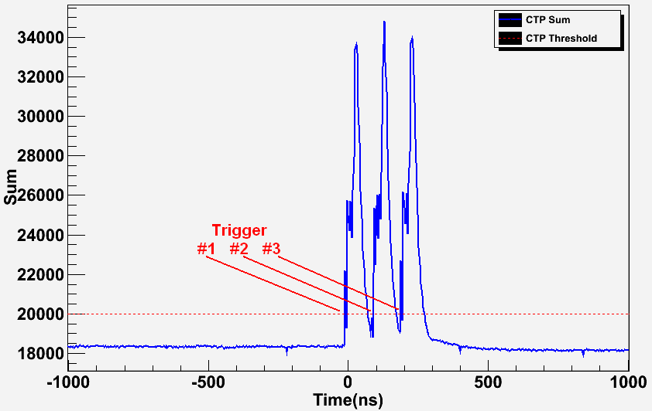
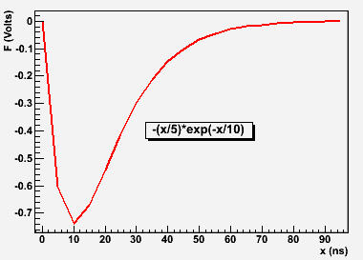
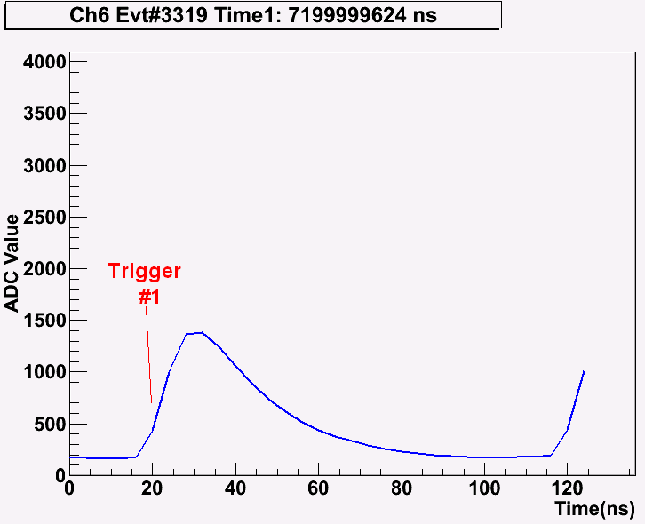
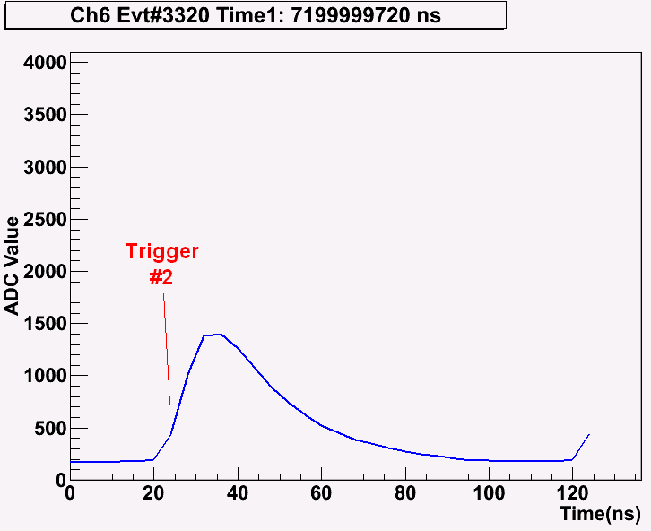
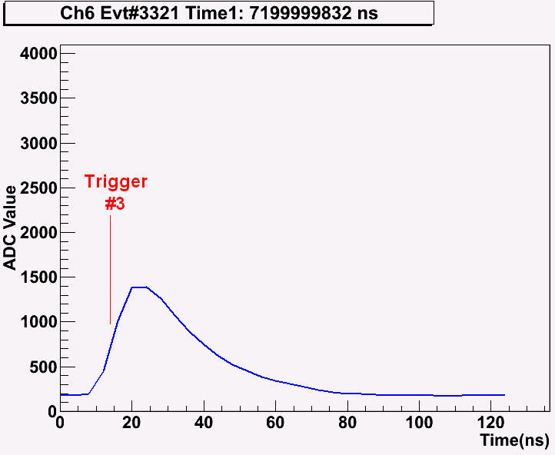
2 Crate Energy Sum Testing
Global Sum Capture (at “SSP”):
Input Signal to 16 FADC250 Channels:
Raw Mode Triggered Data (single channel shown only):
Threshold applied to global sum (96 digitized channels) produces 3 triggers.
Raw channel samples extracted from pipeline shown for 1 channel.
Runs at 250kHz in charge mode
Latency: 2.3µs(measured) + 660ns(GTP estimate) < 3µs
B. Raydo

Slide 24
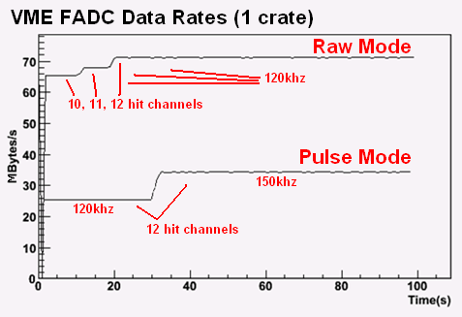
Synchronized Multi-Crate Readout Rates
FADC event synchronization has been stable for several billion events @ ~150kHz trigger rate.
Have run up to 140kHz trigger rate in raw window mode, up to 170kHz in Pulse/Time mode.
Ed Jastrzembski has completed the 2eSST VME Interface on FADC allowing ~200MB/s readout
Single Crate
12 signals distributed
to four FADC250
18% Occupancy
B. Raydo

